Slide 1
ALMS
-creating a brighter tomorrow
SWE3999 - TARP | J Component Final Review
Sai Sahithi Kodavati (18MIS1096), Y Priya Verma(18MIS1072), Harshitha Kuruba(18MIS1064), G Faraz(18MIS1013), N Pranitha(18MIS1095)

Slide 2
Abstract
In today’s world, huge quantity of food is being wasted on a constant basis in our homes, Hotels, weddings and parties and many other places. Many individuals give food, garments and books and so forth physically by visiting better places all alone to address this emergency of yearning just as food wastage in our country. ALMS basically helps us by creating a platform for the donors to donate anything they want to.
ALMS app has two kinds of logins where the user needs to login as either volunteer or a donator. The new users will have to register themselves by giving basic information.Food is dropped in an e-bin where the quality is thoroughly verified. On successful donation a bill is generated.

Slide 3
What made us take up this project.
Many homeless people on streets starve to death where on the other hand tons of food is wasted from many restaurants. We often waste lots of food unintentionally sometimes. Though we want to do something with it like feeding the needy or the street animals, situations may not be very feasible for all of us.
The basic idea of making use of the food and unwanted stuff which might actually be useful to other people in need has given birth to a platform called “ALMS” . An application is an attempt to solve the above problem.

Slide 4
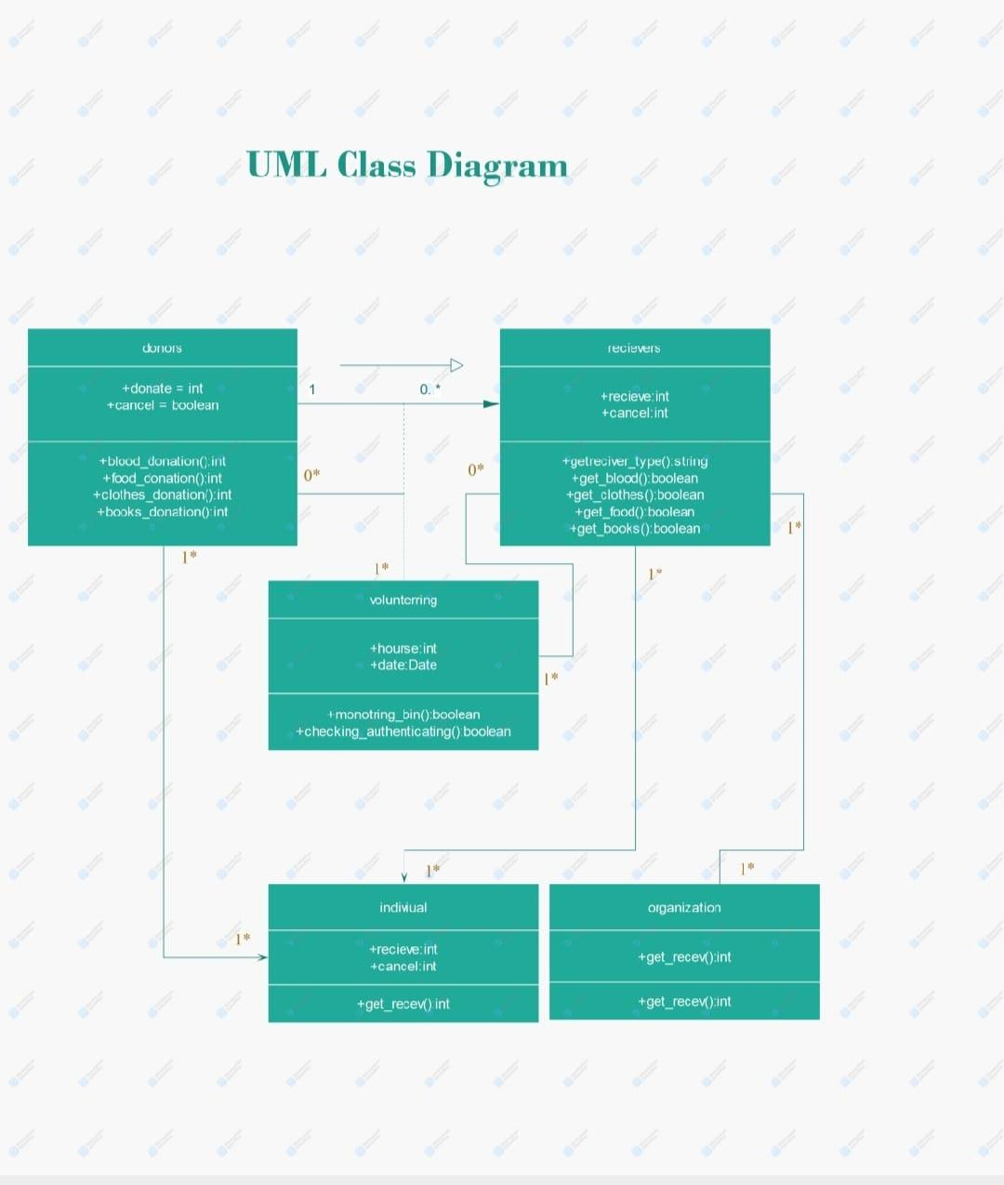
Objectives of ALMS
1
For millions of people in developing countries, food wastage happens. ... Not only chronic poverty, conflict and economic shocks are the reason for hunger worldwide but also food loss is one of the root causes of hunger worldwide. Food loss also represents a waste of the very resources like land, water and energy that are used to produce food . so in order to help people with hunger in order to reduce the hunger and the food wastage issue to an extent the idea of alms. Besides food we are also trying to provide them with clothes and books which are the basic need in the present society.

Slide 5
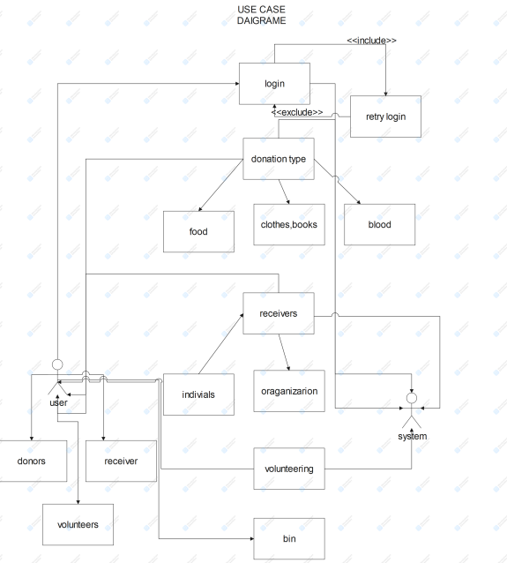
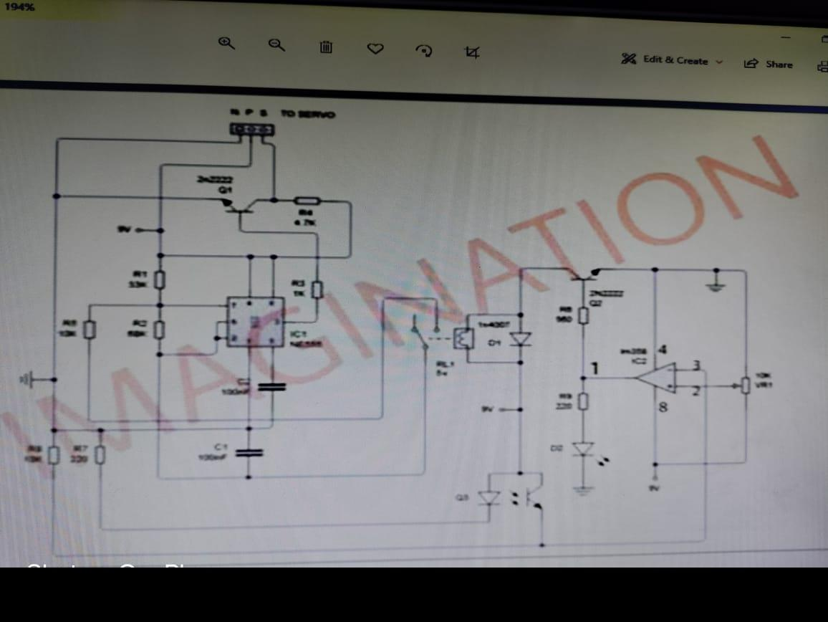
System Design
1

Slide 6
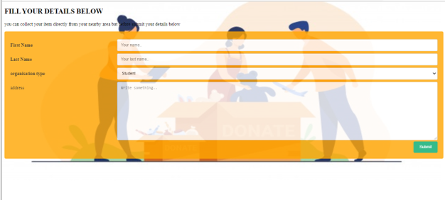
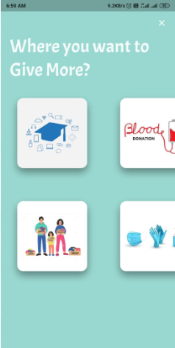
2
What is new?
Through our project users can from anywhere donate the food by checking nearby alms station status through our app. So app shows nearby alms stations available and so people can donate in the nearby stations and they can also donate clothes and books and users can also volunteer to work in the alms stations and get certified for their work. Orphanages or the other users can also see books and clothes if they exist in alms stations through our app and can order them through app and can collect in the nearby stations.

Slide 7

3
Why should people use ALMS?
Alms acts as a bridge between the donors and receivers. There are many people who want to help the needy but due to present day’s schedule they are not able to donate. This smart allows you to donate food, clothes and books whenever you can.
We assure the public that all the items that are being donated will reach to the needy as we have volunteers helping for it.
All the items that are donated today will be distributed immediately and a board which contains the total donations that has already been donated to the needy will be posted near the bin daily.

Slide 8

4
Working of ALMS..
Alms stations consists of two sensor boxes where in one user can put food and the other for clothes and books. this station also has a volunteer and follows all the covid protocols and the cover used to donate will not be throwed they will be cleaned and reused. the user can check for the nearby stations through the alms app interface and can donate, any needy person can take the food from the box.
In order to use the app services the user need to signup and then login and check for nearby alms stations and can go donate also the user in our app can view the nearby blood donation centers too so in emergency it can be useful for alms users and there’s also option in alms app called volunteer so if user wants to volunteer the user has to enter the necessary details and no of hours the user can work and location where he/she wants to work in and they will be certified if they work for certain period of hours in total.
The user’s like orphanages if they want some clothes or books for the children they can login and view the books and clothes available and can order them with proper proofs and details and can collect them from the nearby station. And if the donated food remains at the end the day that food will be fed to the animals and to the needy by the volunteers.

Slide 9
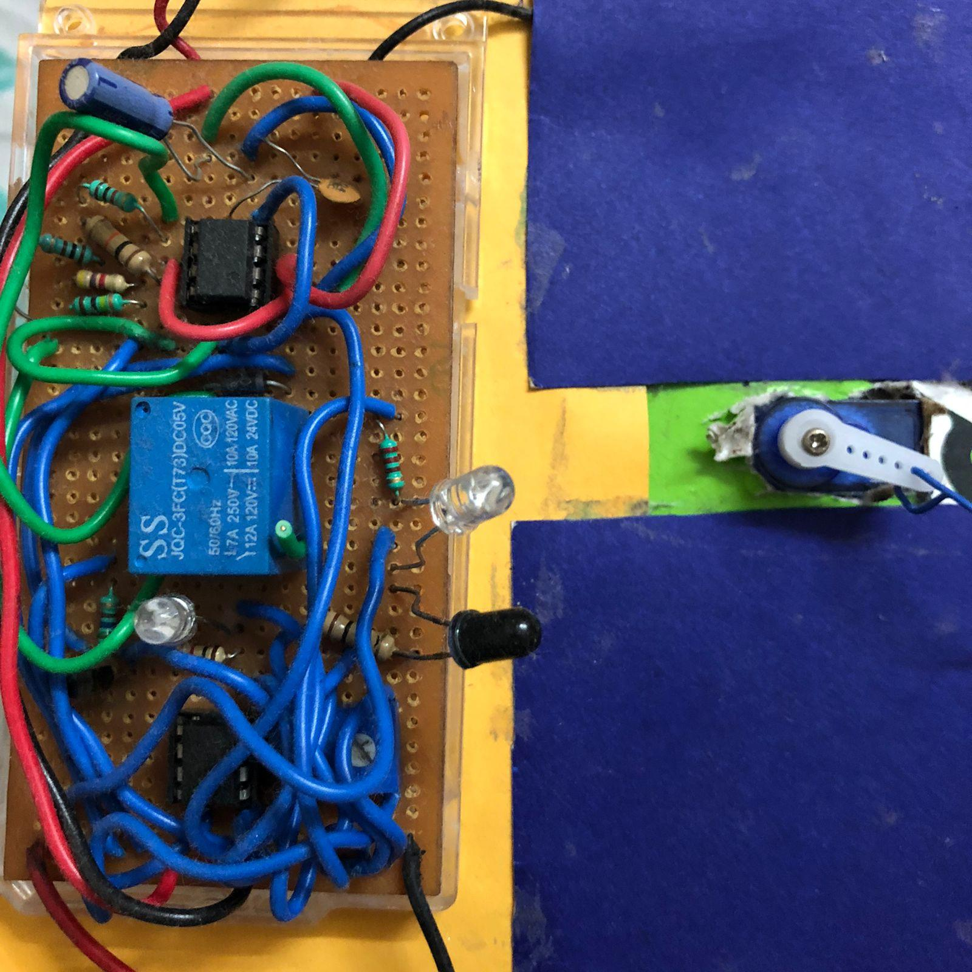
5
Hardware Components..
LM358 op-Amp
5V relay
33 k ohm , 68 k ohm, 100 k ohm, 560 ohm, 220 ohm
2n22 transistor
10K potentiometer
1n4007 diode
100 pf capacitor
555 IC
Transmitter and receiver
(IR sensor)
Servo motor 5V
9v or 5v power supply

Slide 10
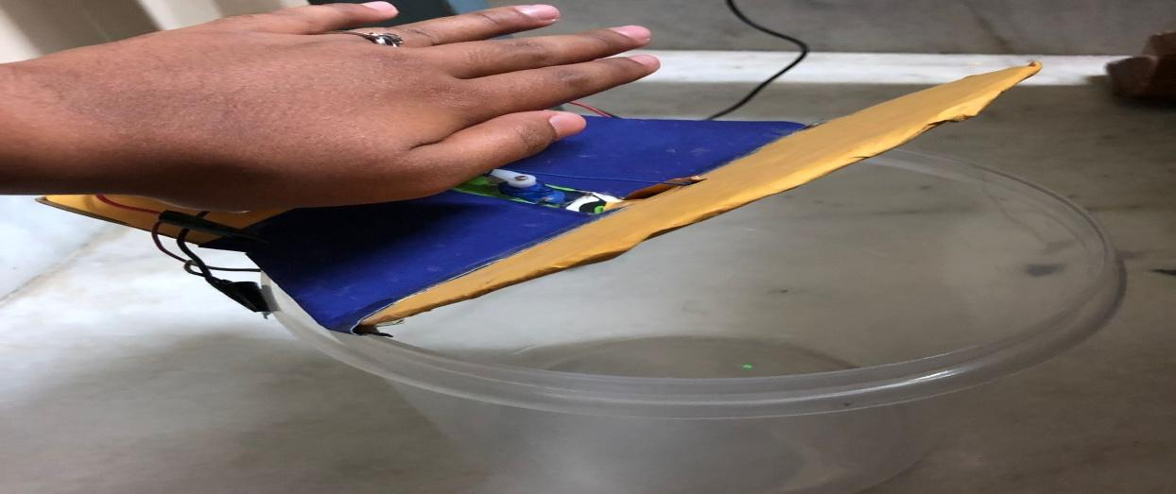
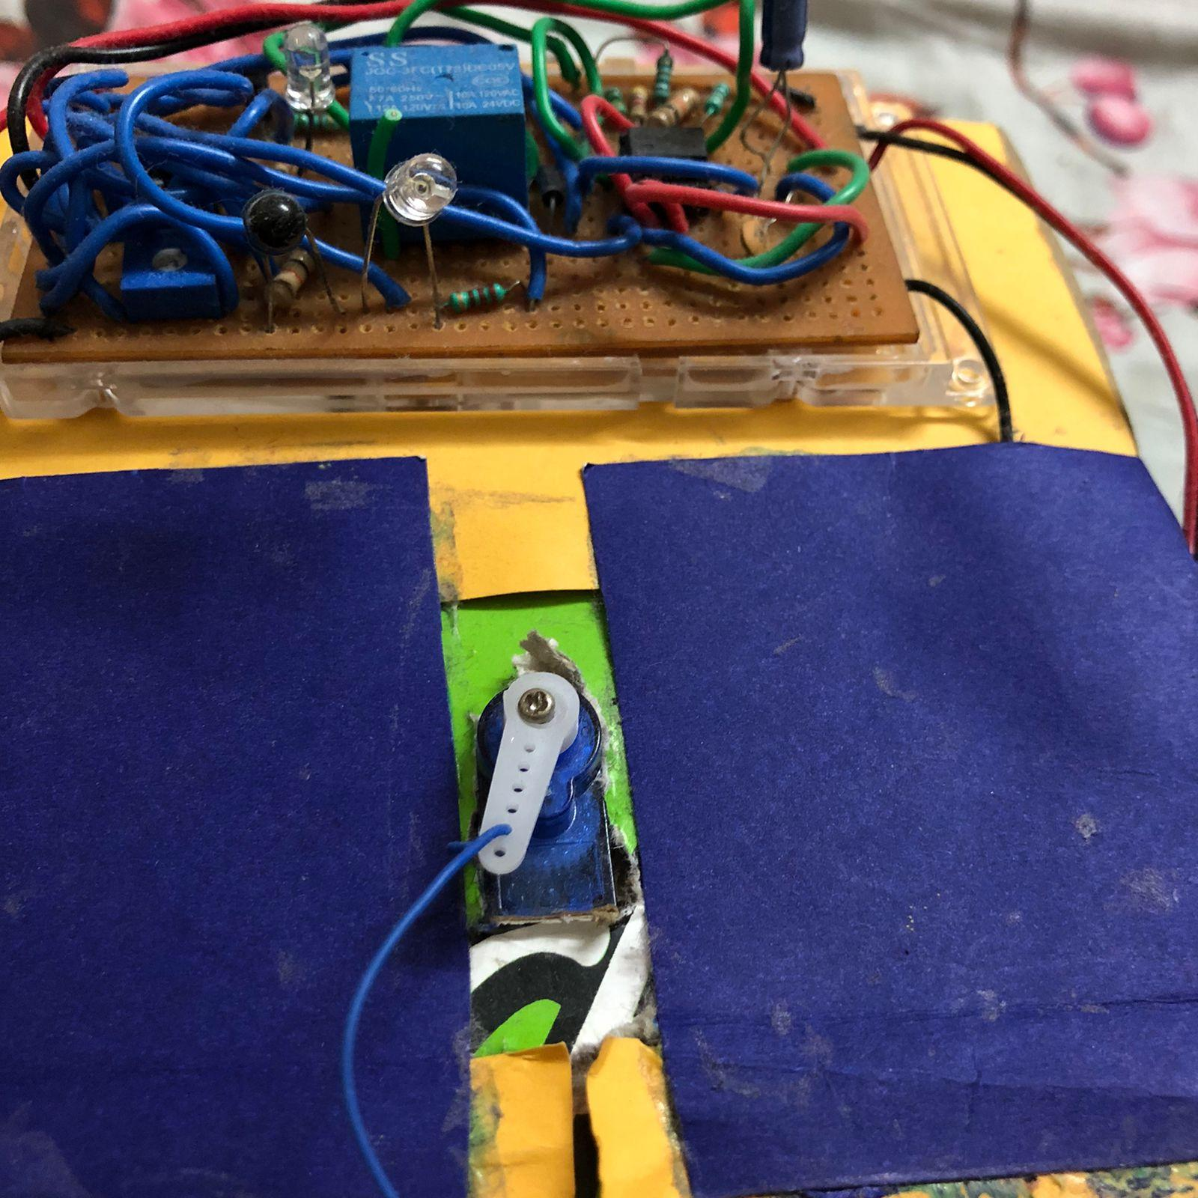
7
Results..
When any object or human hand comes near the sensor the cap of the bin opens enabling the humans to use it.
This is the circuit made using the above listed tools and the center part of the bin is the relay which helps the bin to open the lid.

Slide 11
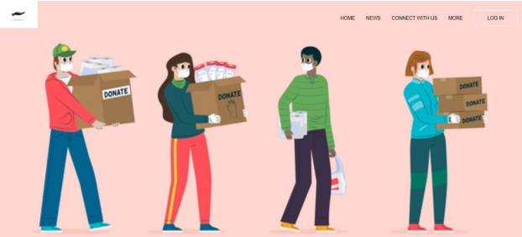
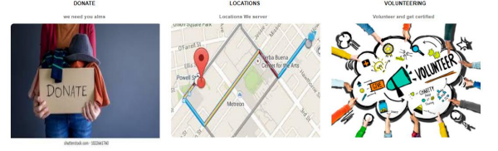
Website
Homepage

Slide 12
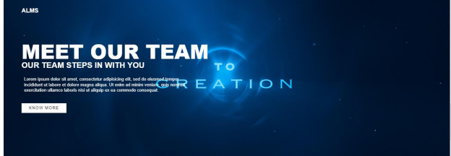
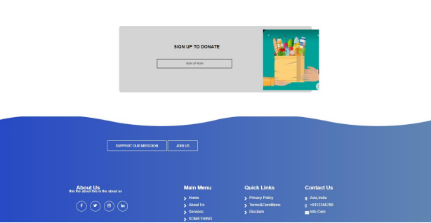
Website
Sign in/Sign up

Slide 13

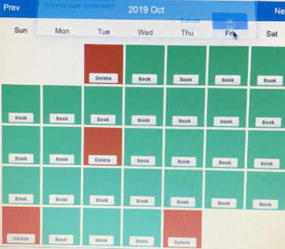
Volunteer slot

Slide 14
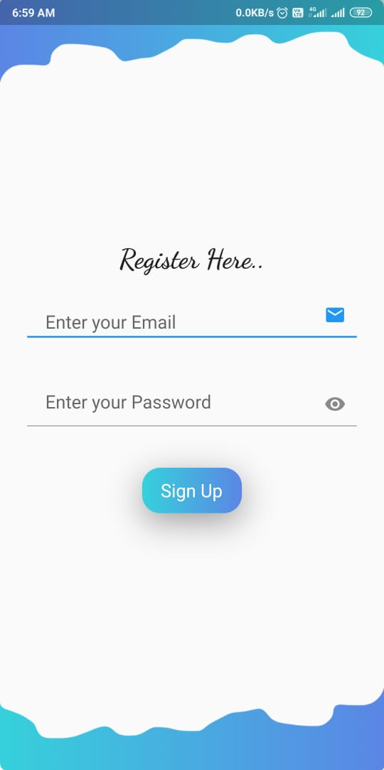
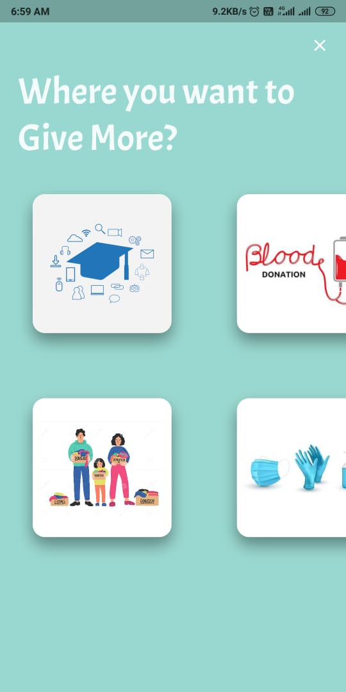
APP (ALMS)

Slide 15
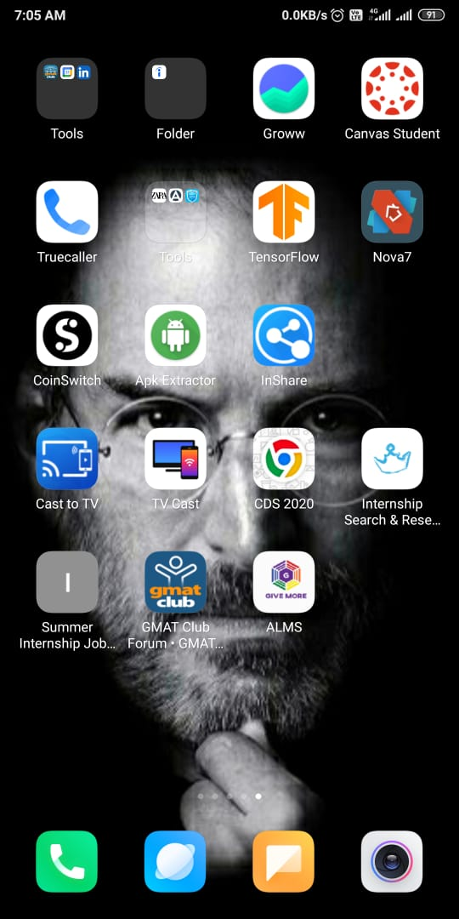
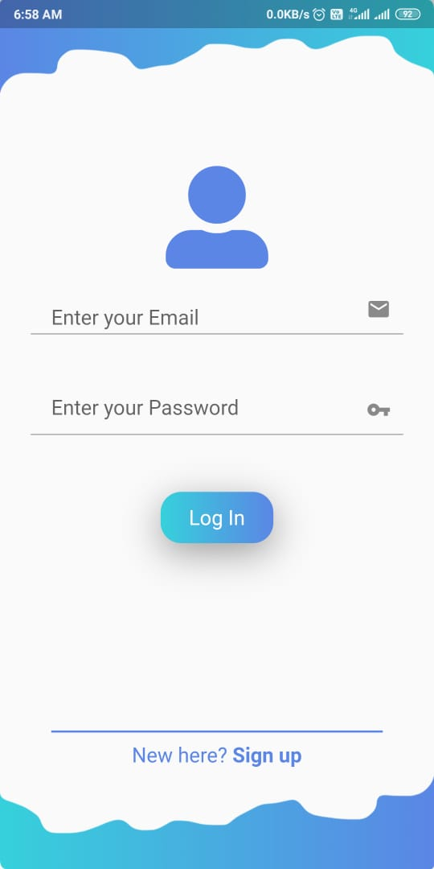
ALMS

Slide 16
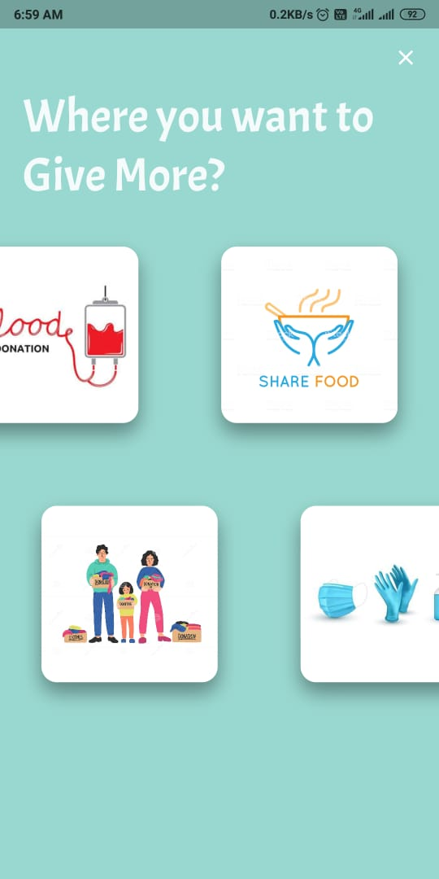
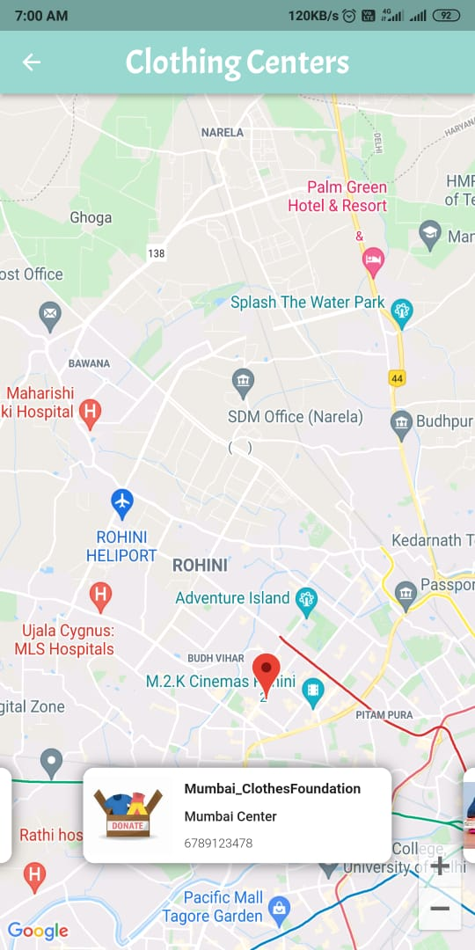
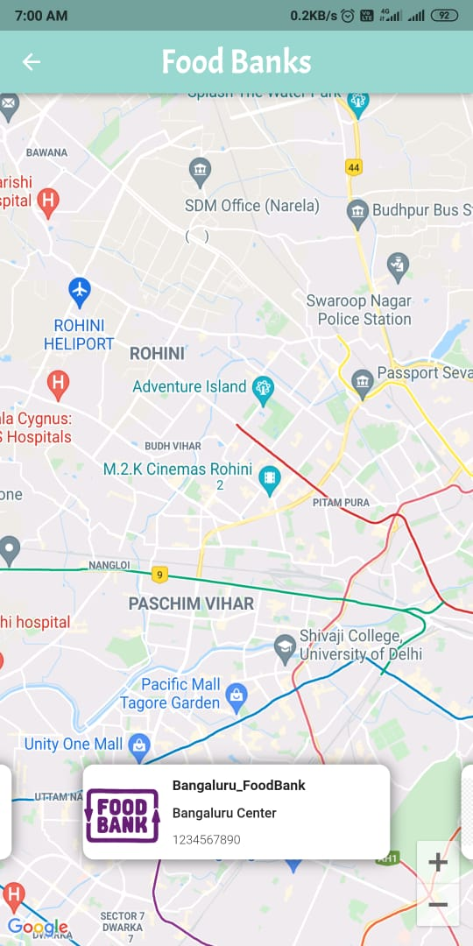
ALMS

Slide 17
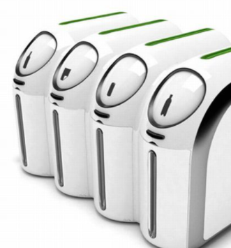
6
What can be the extension…
If the projects succeeds and the aim of the project is been properly met then We want to design a better version for the hardware which includes proper automatic packing of food and better user interface for the app and website and also want to include a feature that connects the alms stations to the nearby restaurants inorder to take the order for remained food at the end of the day and with the help of volunteers distribute the food to street dogs, and hungry people,also want to include a new feature to the hardware to keep the food in the box fresh for a very long time.

Slide 18
References & Resources
http://www.ijirset.com/upload/2018/n3cit/13_CONFERENCE%2030.pdf
https://www.xajzkjdx.cn/gallery/383-april2020.pdf
https://www.ijert.org/review-on-literature-survey-share-my-food-application
https://www.researchgate.net/publication/284726800_Food_donation_An_initiative_to_mitigate_hunger_in_the_world
https://ieeexplore.ieee.org/abstract/document/9375945
https://electronicbazaar.com.au/the-smart-dustbin-without-arduino-or-programming-electronics-project-2/
http://ijarece.org/wp-content/uploads/2016/06/IJARECE-VOL-5-ISSUE-5-1576-1578.pdf

Slide 19
Thank You :)

